Slide 1
Full Stack Development
Star Techies
Team Members:
Adarsh D Acharya 4SF22CI400
Manas 4SF22CI403
Suhas 4SF22CI408

Slide 2
Introduction
Welcome to the world of culinary innovation and technology. In today's fast-paced digital age, food lovers are increasingly seeking convenient ways to discover, save, and share their favorite recipes. The Recipe Application we're about to explore CSS, HTML and js also using Bootstrap.

Slide 3
Problem Statement
Recipe Application: Build a recipe application using MERN stack that allows users to search for recipes, save their favourite recipes, and share recipes with friends.
Problem Statement Brief
Create a recipe application that allows users to easily search for, save, and organise their favourite recipes. The app should also provide features for creating and sharing their own recipes with the community. Additionally, the application should have a user login feature to save user preferences, and allow users to access their saved recipes across multiple devices.

Slide 4
Solution
System requirements for the project
Operating System: Windows
Code Editor/IDE: Visual Studio Code
CSS
HTML
Web Browser: Chrome, Microsoft edge

Slide 5
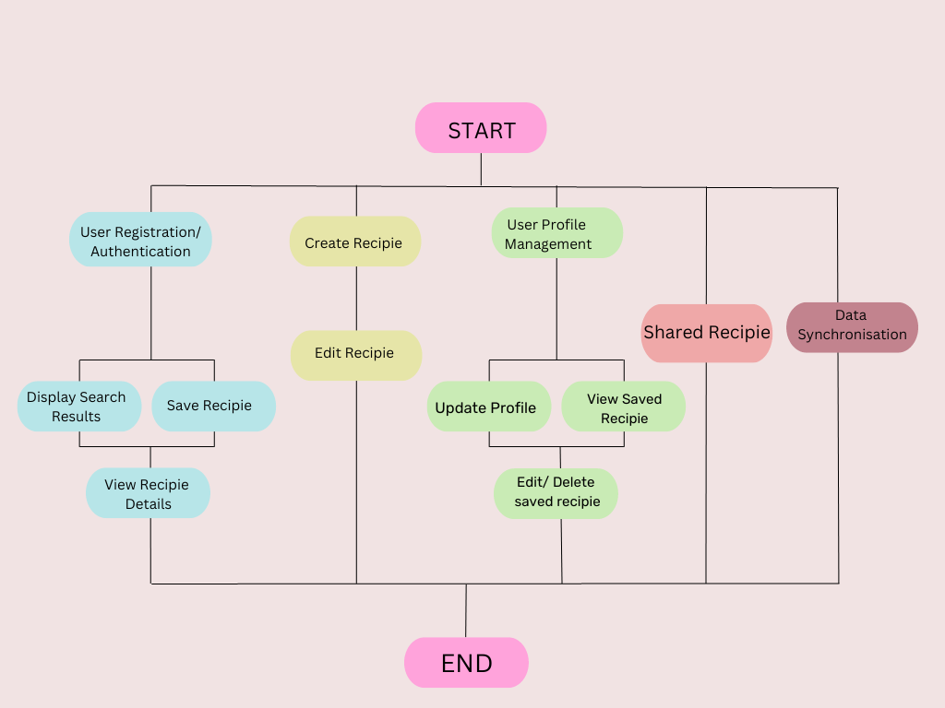
Solution
Flowchart of the project

Slide 6
STEPS
1. Setting Up Your Workspace:
Open Visual Studio Code (VSCode) and create a new folder for your project.
Inside this folder, create separate files for HTML, CSS, and JavaScript.
2. Designing the Layout (HTML):
Write the HTML structure to create the basic layout of your website.
Define sections like header, navigation, main content, footer, etc.
Include elements like headings, paragraphs, lists, and images.
3. Styling the website(css)
Create a css file and link it to your html document.
Apply styles to different elements.
Use properties like ‘color’, ‘margin’, ‘padding’ etc to design layout and appearance.

Slide 7
STEPS
4. Adding Interactive Elements (JavaScript):
Use JS to add interactivity like handling clicks, form submissions, and dynamic content.
5. Creating Navigation:
Implement a navigation bar for easy user access to different sections of your website.
6. Menu and Ordering System:
Design a menu section where customers can view available pizza options.
Implement a form for customers to select their desired pizza and place orders.

Slide 8
STEPS
7. Adding Visuals (Images and Media):
Incorporate images of pizzas and other relevant visuals to make your website more appealing.
8. Responsive Design:
Use media queries in CSS to make sure your website looks good on different screen sizes and devices.
9. Testing and Debugging:
Test your website in different browsers to ensure it works correctly.
Debug any issues that may arise during testing.

Slide 9
Conclusion
In our journey of creating a pizza restaurant website from scratch using HTML, CSS, and js in Visual Studio Code, we've embarked on a dynamic and creative endeavor. Following these steps has enabled us to construct a visually appealing and interactive platform for our customers to explore our offerings and place orders effortlessly. Paying meticulous attention to details such as layout, styling, and functionality has been crucial in ensuring a seamless user experience. Rigorous testing across various browsers and devices has allowed us to fine-tune every aspect, and now, with confidence in our creation, we're ready to deploy it to a hosting service, making it accessible to a broader audience. This process has been a valuable learning experience, and we're excited to share our website.

Slide 10
References
W3schools:
https://r.search.yahoo.com/_ylt=AwrjalLsePVkWL4txOJXNyoA;_ylu=Y29sbwNncTEEcG9zAzIEdnRpZANBREVOR1QyXzEEc2VjA3Ny/RV=2/RE=1693837676/RO=10/RU=https%3a%2f%2fwww.w3schools.com%2f/RK=2/RS=VwCBmWWm3WQ.T0d9WaBQyafmOyU-

Slide 11
Thank You

